Slide 1
Chat-Bot Assisting Hospitalization And Pharmacy In Pandemic Situations
Team Name: IELTS CLOUD STARS

Slide 2



Idea Description(Short)
Idea Id--3337
Theme: COVID-19
Team Name: IELTS CLOUD STARS
Challenge/ Scenario
Solution Approach
Firstly, due to this Covid-19 Pandemic it has become difficult for normal person to find hospitals where beds are available. Even in news we have heard celebrities finding difficult to find hospitals where bed are available.
Secondly, it has happened mostly in our life that we go to Pharmacy shops to buy prescribed medicine but due to empty stock we don’t get medicine and it becomes difficult to find shops where we can find those medicines. It becomes major problem in Pandemic or apart from pandemic situation.
We would have a site where different hospitals and pharmacy shops can register and provide there details in respective modules. The chat bot would be able to communicate with end user to ask if they want to have information regarding hospitalization or Pharmacy shops. On the basis of input from user chatbot will provide the relevant information. Like, if end user chooses hospitalization it will ask user to provide the name of hospital from the list of hospitals registered on our site. Once the name is provided, it can tell if that covid-19 hospital has vacant beds or not and how many. If end user chooses Pharmacy as option, it will ask for the name of medicine, then bot will tell about the nearest shop where the medicine would be available. This would take the geographical location of user and shop to find the nearest shop.

Slide 3

Idea Description(Short)
Idea Id: 3337
Theme: COVID-19
Team Name: IELTS CLOUD STARS
Impact / Benefit of the idea
Target Customers/ Industry
This would have a large impact on urban and rural people, as they would be able save their time in finding the right hospital and shops to get there medicines. In some emergency cases, it would be helpful for people to have exact knowledge and it will avoid cases where people are on receiving end of not being on time for getting hospitalized or having the required medicines.
Even we can add other hospitals which are not providing the covid-19 facilities and provide the solution at the state and the country level as well in future. This can be easily done by extending our product to max hospitals and pharmacy shops and would need a database to maintain that nothing extra would be needed.
Considering our product as whole, it will be intended for 2 categories of people. Firstly, it will be for hospitals and pharmacy who would be sharing there information on our site to be used by actual end users. This would be virtually advertising for them and people would be aware about the details.
Secondly, the end users (common people) who often get on the wrong side of it in situations like covid-19 pandemic and even in normal cases. This would save a lot of time which gets wasted while hopping and finding the right hospital or pharmacy shop for there need.

Slide 4
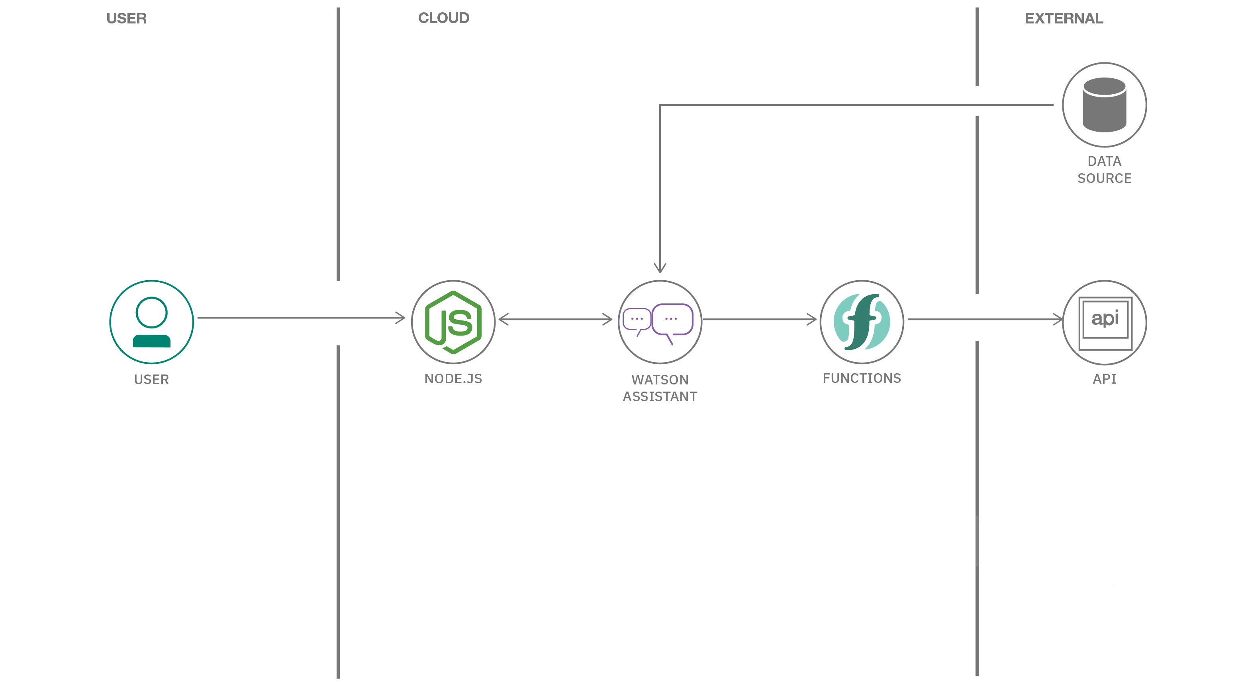
Idea Description(Short)
ARCHITECTURE :

